Slide 1
WHAT DOES IT TAKE?

Slide 2
WHAT DOES IT TAKE?
To Become A Fully Devoted Follower of Jesus Christ?

Slide 3
^{Luke 9:} 23 Then he said to them all: “Whoever wants to be my disciple must deny themselves and take up their cross daily and follow me”
The Woman at the Well
We must reflect at Christians on our BROKENESS.
We must be open/bold about sharing this experiences with others.
3. We must be clear in our message.

Slide 4
I Peter 2:1-11
1. We should rid evil
2. We should crave good
3. We should grow spiritually

Slide 5
Becoming a Fully Devoted
Follower of Jesus
STEPPING DOWN
Matthew 20: 20-28
John 13: 1-10
Philippians 2:5-11

Slide 6
S – Spiritual Gifts (what are yours)
H – Heart (what is your passion)
A – Abilities (what can you do)
P – Personality (how God made you)
E – Experiences (in life - painful and happy)
R – Resources (what’s at your disposal – time, money

Slide 7
I Will Make You Fishers of Men
Luke 5:1-11

Slide 8
Jesus was looking for FISHERMEN
not Super Stars.
vs. 1-2

Slide 9
Jesus looks for FISHERMEN with boats.
vs. 3

Slide 10
Jesus looks for FISHERMEN who will go out into the deep water.
vs. 4

Slide 11
Jesus looks for FISHERMEN who know how to use their net.
vs. 5-6

Slide 12
Jesus is looking for FISHERMEN who are willing to be His partners.
vs. 7-10a

Slide 13
Jesus looks for FISHERMEN who are 100% sold out for fishing.
vs. 10b-11

Slide 14


Slide 15
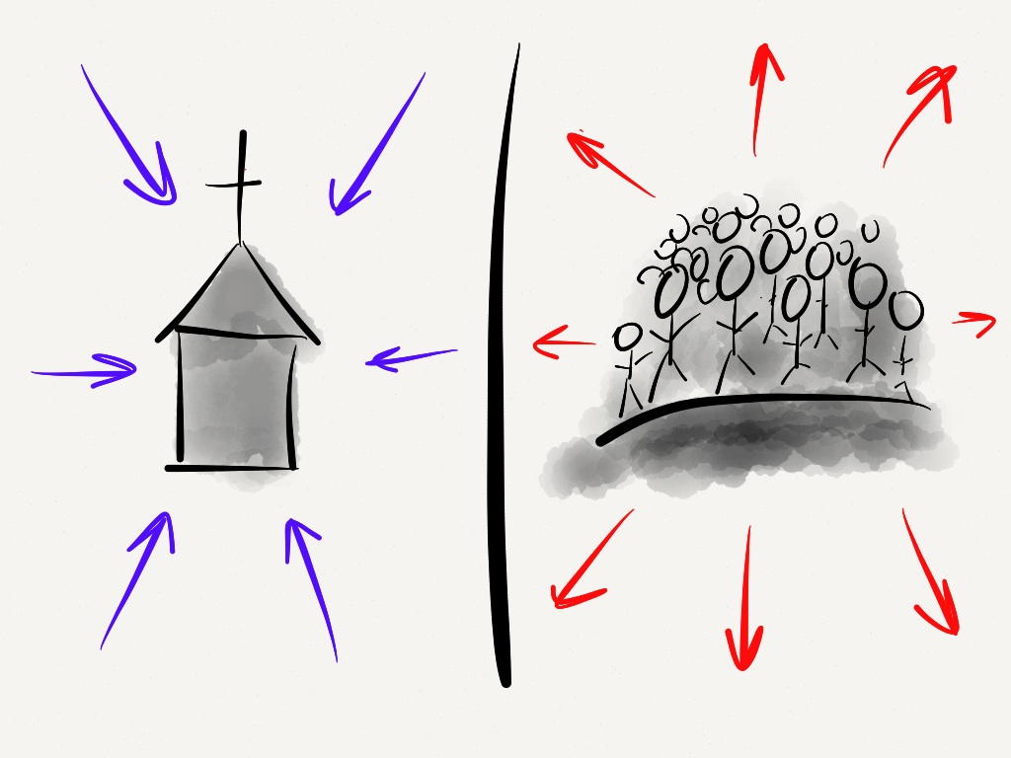

Slide 16
DO YOU FEEL LIKE DOING
A LITTLE FISHING?

